Slide 1


Summit Agility Portfolio
Megan Lytle
719-229-5825
Summit-Agility.com
Summit-Agility@outlook.com

Slide 2


Skills and Competencies
Project & Team Support: Agile planning, task tracking, and deadline management
Technical Troubleshooting: Git, VS Code, Azure, CSS/HTML fixes
Brand & Asset Management: Logo and graphic creation, brand consistency, privacy compliance
Administrative Support: SOPs, document prep, Microsoft Office, email/calendar coordination
Creative Direction: Visual asset creation, layout review, marketing materials
Professional Traits: Detail‑oriented, boundary‑focused, a cost‑conscious, problem‑solver
Skills and Competencies

Slide 3




Previous Climbers: Are You Ready to Reach the Summit?
Scrapped: Repurposed Hardwood Floors
Business Site & Operations
Social media
Summit Agility
Branded, Modeled, Delivered
Lytle Electric
Internal Operations & Administration
Public Presence
Key Achievements & Awards
Presentations
Western Slope Working Line Shepherds
Introduction
Concept Build & Financial Validation
Art of Breeding Champions
Puppy Countdown

Slide 4
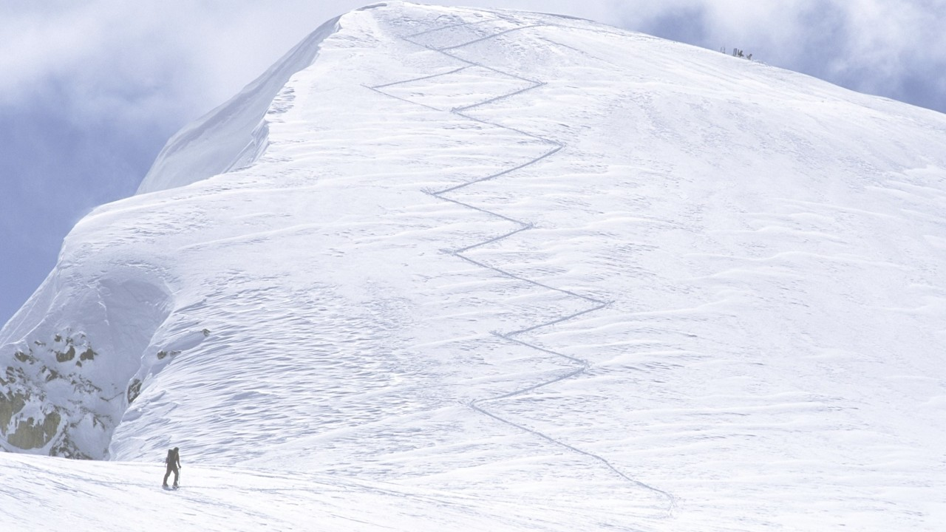
Proof. Precision. Protection.
Vision Statement:
At Summit Agility, we envision a world where every individual and organization can thrive through the power of clear communication, collaborative spirit, and adaptive strategies. We aim to be the guiding force that empowers teams to reach their highest potential, fostering a community where growth, innovation, and human connection flourish.
SUMMIT Agility

Slide 5

Protect the Brand. Prove the Work.
If it’s not built, it doesn’t get shown.
Receipts back every slide, site, and service.
Brand boundaries are real — no crossover unless it’s approved.
No placeholders, no hypotheticals. What you see is what’s deployed.
Visuals, copy, and code are locked before launch.
If someone asks, we can prove it — with screenshots, commits, or live links.

Slide 6


Speed with Depth—agility with Integrity.
Mission Statement:
Our mission at Summit Agility is to provide exceptional support and tailored solutions that enable individuals and organizations to navigate the complexities of change with confidence and clarity. We are dedicated to cultivating environments of trust and open dialogue, where every voice is heard, and every idea has the opportunity to shine. With a commitment to excellence and a human-first approach, we strive to empower our clients to achieve their goals and build a better future, one collaborative step at a time.

Slide 7
What Summit Agility Delivers
Brand architecture
Privacy & compliance docs
Visual identity systems
Agile facilitation & sprint support
Technical troubleshooting

Slide 8
Credentials
LeadingEdge™ Certifications– Pikes Peak Small Business Development Center - Strategic Planning
LeadingEdge™ Certifications– Pikes Peak Small Business Development Center - Cybersecurity
LeadingEdge™ Certifications– Pikes Peak Small Business Development Center - Transportation & Government Contracting
LeadingEdge™ Certifications– Pikes Peak Small Business Development Center - Nonprofit Business Management
Nominated for Member of the Year by the Southern Colorado Women’s Chamber of Commerce
WIOA Scholarship
Minority Business Office Scholarship
$100k within the first 8 months
5-Stars for over 5 years
32% YoY Revenue Growth
SBDC LIVE! on The Extra Business Edition** | Cybersecurity Awareness Month podcast with Ted Robertson, Dr. Shawn Murray, and you | [Listen on Podbean](https://krdonewsradio.podbean.com/e/sbdc-live-on-the-extra-business-edition-with-ted-robertson-aikta-marcoulier-october-23-2020/)
Colorado Springs Business Journal Profile** | Full feature article: *“Connections Spark Small Company’s Growth”* | [Read article](https://www.csbj.com/premier/profiles/businessprofiles/connections-spark-small-company-s-growth/article_979498df-607d-51e2-a736-3ee3c6b6a7e1.html
Professional Continuous Improvement (post-Graduate)

Slide 9


Scrapped Repurposed Hardwood Floors
Scrapped – Concept Build & Financial Validation
Not every brand goes public. But every build gets proven.
Scrapped was a reclaimed hardwood resale concept backed by environmental logic and market demand. Though the pitch was shelved, the work was real — and the proof lives in spreadsheets, slides, and strategy.
Built break-even and pricing models in Excel
Drafted brand architecture and visual identity
Created a full One Million Cups pitch deck
Supported operational logic and environmental messaging
Shelved the launch, retained the receipts

Slide 10
Scrapped: Branded, Modeled, Delivered

Slide 11


Lytle Electric LLC
Lytle Electric – Business Site & Operations
Built mobile‑friendly business site
Wrote service descriptions based on real work
Created a custom icon suite for navigation
Coordinated SOPs, forms, and internal docs
Enforced brand boundaries across all assets
Skills: Website setup, admin support, brand management, content writing, process documentation

Slide 12

Lytle Electric LLC
Lytle Electric LLC – Internal Operations & Administration
Coordinated multiple electrical projects from scheduling to completion
• Managed bookkeeping, invoicing, and payment tracking
Scheduled and confirmed client appointments
Oversaw staff schedules and workload distribution
Created HR materials: employee handbook, onboarding templates, exit interview forms
Maintained compliance records for licensing, insurance, and safety requirements
Skills: Project coordination, bookkeeping, staff management, scheduling, HR administration, compliance tracking

Slide 13


Lytle Electric LLC
Public Presence
Title: Lytle Electric – Social Media & Outreach
Managed social media accounts and post scheduling
Created seasonal and service‑specific campaigns
Responded to inquiries while maintaining brand tone
Designed promotional flyers and handouts
Coordinated with the owner for timely updates
Skills: Social media management, marketing content creation, customer engagement, visual coordination

Slide 14

KEY ACHIEVEMENTS
SCALED A STARTUP FROM $2K TO $100K IN 8 MONTHS (10,000% ROI IN YEAR ONE)
DOUBLED A NONPROFIT’S ANNUAL BUDGET THROUGH TARGETED GRANT ACQUISITION
BOOSTED RESTAURANT WEEKEND SALES FROM $100 TO $1,000+ WITH UPSELLING STRATEGIES
LED CYBERSECURITY GOVERNANCE, EARNING THE REGION’S FIRST CYBER AWARE CERTIFICATION
AWARDS & RECOGNITION
2020 – NOMINATED BEST OF THE SPRINGS, THE GAZETTE
2019 – FIRST COMPANY AWARDED CYBER AWARENESS BADGE
2017–2019 – TOP RATED WITH HOME ADVISOR
2017–2019 – ELITE SERVICE WITH HOME ADVISOR
2018 – NOMINATED FOR MEMBER OF THE YEAR FROM SCWCC
2018–2022 – AGE‑FRIENDLY CERTIFIED BUSINESS
2018–2022 – BBB A+ ACCREDITATION
2019 – FINALIST, EXCELLENCE IN CUSTOMER SERVICE AWARD
🎙 Media & Recognition Highlights
KRDO Newsradio – Excellence in Customer Service Award Recipients | Ted Robertson’s Afternoon News segment featuring BBB honorees, including Lytle Electric
SBDC LIVE! on The Extra Business Edition
Cybersecurity Awareness Month podcast with Ted Robertson, Dr. Shawn Murray, and Megan Lytle |
SCWCC Accolades Commercial – Platinum Sponsor Feature
Video spotlight featuring Lytle Electric as a Platinum Sponsor for Accolades 2020
Colorado Springs Business Journal Profile
Connections Spark Small Company’s Growth

Slide 15
Lytle Electric- Presentation Slides
Created clear, easy-to-read slides for Lytle Electric to help share business info, community involvement, and cybersecurity services. Focused on making the message simple, professional, and valuable for real audiences
Click icons for more information

Slide 16


Western Slope Working Line Shepherds LLC
Summit Agility supports Western Slope Working Line Shepherds with visual branding, presentation assets, and platform setup, designed to foster long-term credibility and owner engagement.

Slide 17


Art of Breeding Champions
Tactical Support & Documentation
Configured social accounts for brand cohesion and future content
Documented collar logic and litter tracking for internal use
Formatted updates for owners and breed partners — consistent, receipt-backed, and breed-specific
Visual Identity & Breed Messaging
Designed logo and graphics aligned with working line traits
Created scalable visuals for flyers, social posts, and breed outreach
Built presentation slides for owner education and temperament clarity.

Slide 18

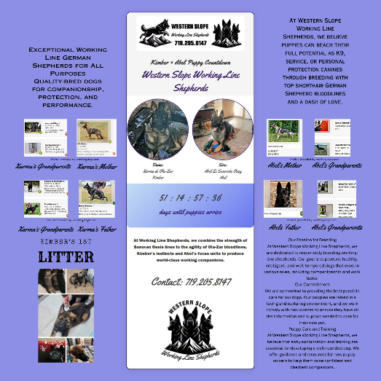
Summit Agility ensures that every asset reflects the integrity of the breed and the professionalism of the program. Visuals are built to scale, communicate clearly, and support real-world handoffs and lineage tracking.
Puppy Countdown – Skills Demonstrated
Designed a visual countdown to track and share key dates leading up to litter delivery, applying:
Graphic layout and spacing for clear milestone visibility
Typography selection for readability at a glance
Color coding to differentiate stages and events
Date tracking logic to ensure accuracy
Puppy Countdown – Skills Demonstrated for both digital and print use

Slide 19
Lytle Electric Social Media Campaigns
Punny Ads and Promotions
When you think of Light
Think Lyte
A campaign targeted to inspire by using
inspirational quotes with the word “Light” in them to help brighten someone’s day.

Slide 20


